Slide 1
PYTHON PRORAMMING FOR DATA SCIENCE AND MACHINE LEARNING
Vincent Appiah
RUNMILA AI INSTITUTE

Slide 2
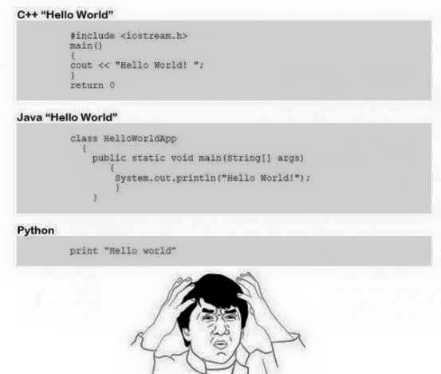
A LITTLE COMPARISON

Slide 3

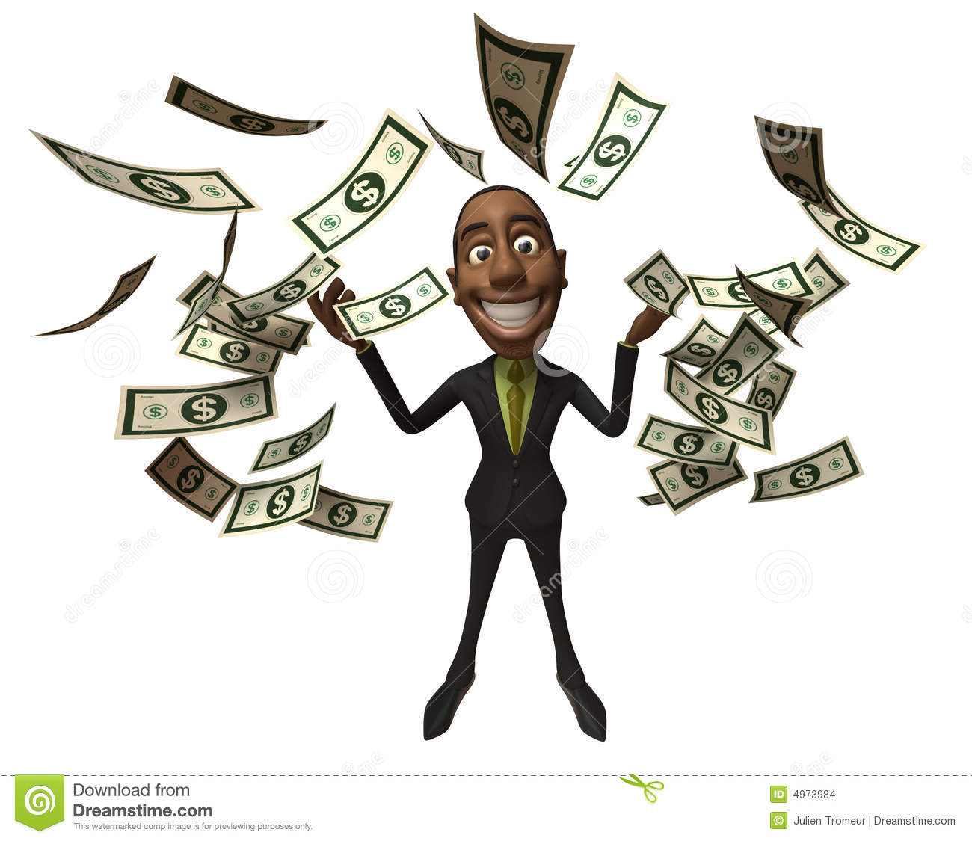
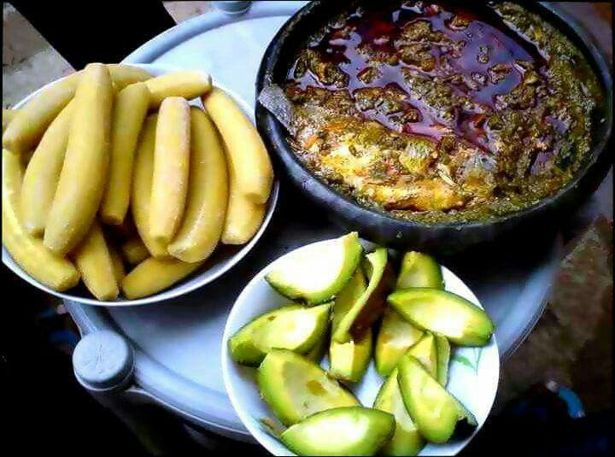
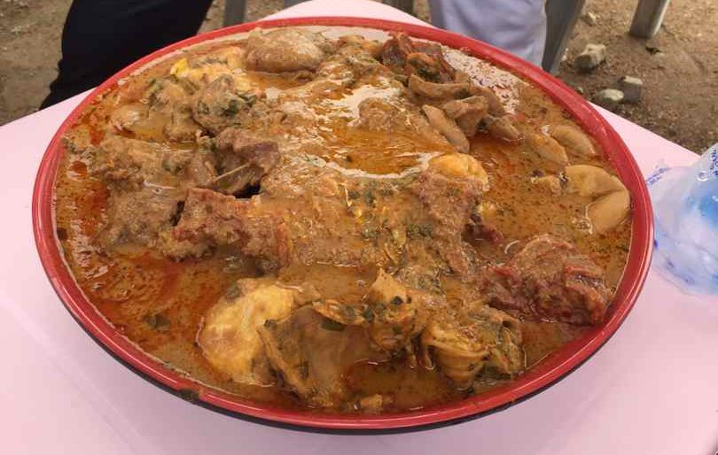
EVOLUTION OF PYTHON

Slide 4

LETS INSTALL PYTHON ON OUR PC
Windows
-Open your web browser
-Visit https//www.python.org
-Download python 3.x
- You must also download pythonwin which is for windows extension.
It is available at https://sourceforge.net/projects/pywin32/
Unix
-Chances are python is already installed.
- Install the IDLE for python 3 (method of installation depends on the unix environment. Documentation is readily available on the internet)

Slide 5
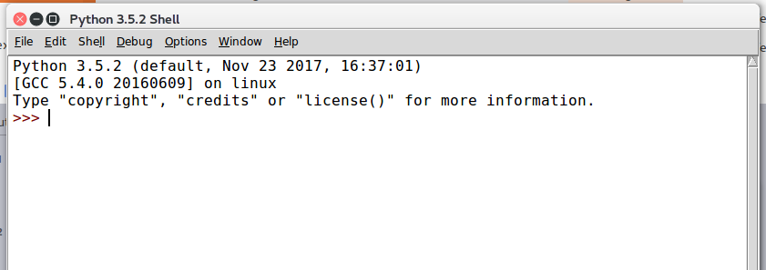
ITS TIME TO TEST OUR INSTALLATION
Windows
Start>Programs>Python>IDLE
Unix
Search for IDLE 3 among your applications
You should see this

Slide 6

HURRAAAYYYY!!!!!!!!!!!!
Lets Celebrate the first milestone with a glass of wine

Slide 7

READY FOR THE NEXT ROUND???
LETS GO

Slide 8
BASIC SYNTAX
‘#’ - any character after the # symbol is considered to be a comment
Any other line is considered to be part of the code.
To display a value on the interactive shell use the command print . eg.
>>> print('hello world')
hello world
>>> print(1)
1

Slide 9
VARIABLES
When we are assigning a value to a variable we use the equal (=) sign
Eg if we want to assign the value 2 to a variable x the syntax is
>>> x= 2
Lets print x
>>> print(x)
2

Slide 10
BASIC DATA TYPES
Boolean
- True or 1
- False or 0
Numbers
- Integers
- Floating point numbers
Strings
List
Tuples
Dictionaries

Slide 11
NUMBERS
Integers are whole numbers eg. 1,2,3,10,12
Floats are decimals eg. 0.1, 2.1,20.5
>> num =3
>>>print(num)
3
>>>print(num+5)
8
>>> print(num/2)
1.5
What is happening? 3/2 should give you 1.5 but you get 1.

Slide 12
NUMBERS CONT'D
Python by default returns integer values when performing numerical operations.
To display floats you need to convert your numbers to float.
There are several ways of doing that but we shall look at only two.
1. Use the keyword float eg.
>>> float(3)
3.0
2. Enter your values in floats eg.
>>> 2.0
Now lets perform the division operation again. Does python return the expected results?
>>> float(num)/2
1.5

Slide 13
MATHEMATICAL AND LOGICAL OPERATIONS
+ plus
- minus
/ division
* multiplication
** exponent
% modulo
< less- than
> greater- than
<= less- than- or- equal
>= greater- than- or- equal
== equal

Slide 14
STRINGS
String is a sequence of characters. Characters are anything that can be typed on the keyboard. It can be numbers, alphabets or symbols.
In python strings are created by putting them in single or double quotes
Example of a string object is “hello world” or “ghdatascience” or ‘Data Science Summit’
Strings can span one or more lines.
For multiline strings we place the characters in triple quotes eg.
‘’’ This is
a multiline string ‘’’
Alternatively we could do this. “This is \na multiline string”
The \n represents a newline . (More on that later)

Slide 15
ESCAPE CHARACTERS
\t tab character
\n newline
\\ backslash
\’ single quote
\” double quote

Slide 16
LET US CREATE SOME STRINGS
>>> mystring='Python programming'
print(mystring)
>>> mynumber='123'
print(mynumber)
Note: 123 is not the same as '123'
the latter is a string(because of the quotes) and the former is an integer

Slide 17
STRING MANIPULATION
You can add two strings (concatenation)
>>> string1='hello'
>>> string2='world'
>>> string3=string1+string2
>>> print(string3)
Finding the length of a string
>>> len(string1)
4

Slide 18
INDEXING STRING CHARACTERS
String characters can be located using their index (position)
Eg. Lets take a look this string mystring= 'Python'
What is the first character?
>>> print(mystring[0])
P
What is the last character
>>> print(mystring[-1])
n
Note: Python starts its indexing from zero(0)

Slide 19
STRING METHODS
You can perform addtional operations on strings
eg. Making a string all uppercase
>>> string1='python'
>>> print(string1.upper())
>>>pring(string1.lower())

Slide 20
ADDITIONAL STRING METHODS
string.upper() Makes a copy with all alphabets in uppercase
string.lower() Makes a copy with all alphabets in lowercase
string.find('a') Find the first position where 'a' occurs in the string
string.count('s') Counts how many 's' characters are in the string
string.lower() Copy of string with all characters converted to upper case
string.upper() Copy of string with all characters converted to upper case
string.isdigit() Checks if string contains only digits. Returns True or False
string.isalpha() Checks if string contains only alphabets. Returns True or False
string.alnum() Checks if the string contains alphanumeric characters only. Returns True or False
string.strip() Strips a character from both sides of the string
string.split() Splits the string into a list of substrings
string.replace('s','t') Replaces all 's' in the string with 't'
string .join(list) Joins all members of list into a single string object

Slide 21
LIST
A list is linear collection of items
A list can contain other types of data objects
Each item in a list is assigned with an index value.
So specifying the index will return the item present in that index.
If the specified index does not exist, an exception is raised.
( more on exceptions later)
A list is created by enclosing the data in square brackets..
A list is mutable, meaning you can change its contents.
Every item that is added goes to the tail ( end of the list)
Iterations can also be performed on lists.

Slide 22
CREATING A LIST
mylist=[value1,value2,value3]
eg. create a list with the members 1,2,3
numbers=[1,2,3]
Lets create another list with the hashtags of the workshop
hashtags=['indabaxgh','ghdatascience']
Create another list with components of Data Science
components =['machine learning','statistics','mathematics',business analytics']

Slide 23
LOOPS
Loops provide a way of iterating a sequence of items and execute statements on the items.
Python has two loop methods :
- for loop
- while loop
We loop on strings,lists, tuples.
For this workshop we will look at the for loop.

Slide 24
LOOPS CONT'D
for loop is used for iterating over a sequence of items. During the iteration, operations can be performed on the items.
Its time for looping
Lets loop over this string 'Python'
string='Python'
for i in string:
print(i)
Notice that the line after for statement is preceeded by space characters(usually a tab: 4 space characters). This tells Python that all statements with the tab are part of the for loop and must be executed during the cycle. Block statement are made by ending that line with ':'

Slide 25
FUNCTIONS
Before we look at functions. Let us consider this code
x=1
y = 2
print (x + y)
(enter all codes line by line in the code editor and then run)
Lets say we want to repeat these 3 lines of code in the same editor.
At a glance what shall we do? We copy again ?
It will be easy to copy or even type the 3 lines of codes again. But what about if we are dealing with about 50 or more lines of code. ?
Are we going to copy again? What about overall number of lines of codes.?
As a result, multiple copies of codes will be generated. Do you see the redundancy here?
This is where functions come in.

Slide 26
FUNCTIONS CONT’D
Functions offer a way of grouping lines of codes making them reusable without having to copy or type all over again.
Functions also allow us to specify custom inputs which are then executed by python(parameters)
Note: Python comes with some functions . These are called in-built functions. Functions that the user creates are called user-defined functions. For this lesson we shall get to use some in-built functions as well as create our own functions.
So how do we create a function? Its as easy as ........

Slide 27
CREATING FUNCTIONS
A function is defined by def statement
General syntax is
def name():
statements
where name is the function name
statements are commands that will be executed when the function is called.
a function can also return a value
To return a value in a function we preceed that value with the keyword return
You should also note that when you use the return keyword, python will stop when it reaches the return keyword. More on this later.
Functions are not executed automatically. To execute the codes under a function you call the function name.

Slide 28
CREATING FUNCTIONS CONT’D
Now lets go back to the addition task from the previous slide.
We would like to create a function which will add two numbers and print the results
def add():
x=1
y=2
print(x+y)
We have created the function . Now lets call the function
add()
What happens?
Do you see the output?
Sometimes you woulld like a function to accept inputs when it is called. In this situation we add arguments. Lets demonstrate it with a function accepts two inputs ( a & b) and adds them.
def display(a,b):
c=a+b
print(c)
Now call the function and see what happens

Slide 29
IMPORTING MODULES
Some python modules by default are not made available to the interpreter. To use these modules you have call them (import) .
To call a module, the syntax is
import module
or from module import *
or from module import submodule
or import module.submodule
You can also use an alias for a module. This is useful if the module being imported has a long name.
eg. import module as alias
Note: * in this context means all

Slide 30
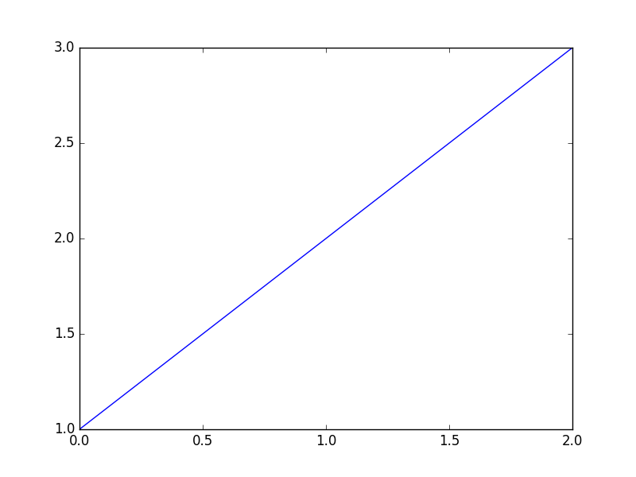
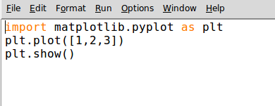
LETS IMPORT A MODULE
We are going to import the library matplotlib and plot graphs with it
Congratulations!!!!!! You have successfully performed a data visualization with Python. ( Reward yourself with a Beer)
Output

Slide 31
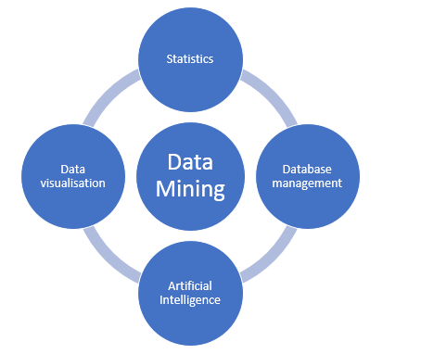
DATA MINING

Slide 32
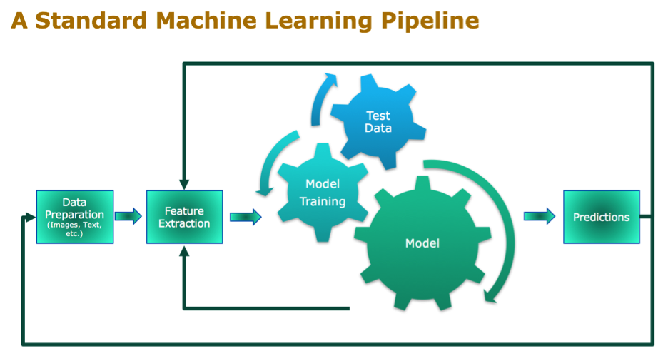
MACHINE LEARNING
https://gokulchittaranjan.wordpress.com/2015/09/08/nlppipelines-1/

Slide 33
METRICS
ROC
AUC
F1
ACCURACY
CONFUSION MATRIX

Slide 34

CONGRATULATIONS. YOU CAN NOW CONTINUE ON YOUR PROGRAMMING JOURNEY CONFIDENTLY

